Slide 1

Making this resource work for you
Prior to teaching this lesson, please refer to the ‘Unit Overview and Planning Document’.
Further guidance on planning Science Mastery lessons can be found in the detailed planning guidance document.
Refer to the ‘notes’ section on each slide for useful information, including suggested expositions, pedagogical content knowledge, suggested questions, answers and more. Consider using presenter mode so you can see this guidance throughout the lesson.
The introduction slides can be adapted to suit your teaching style and the needs of your class.
Before the lesson, adapt the fix-it slide to address any misconceptions identified in the previous lesson’s exit ticket.
Choose from the suggested activities to suit your class. The intention is not that you complete all of these, but that you select those which ones are most appropriate for your students. It may be appropriate to further adapt activities for your students.
These lessons are designed to occupy approximately 1 hour. To adapt for a shorter or longer lesson duration we advise you to adapt the activity section accordingly.
Please consider using the final slide to send feedback about this lesson or examples of PowerPoints that you have adapted to our design team. Your feedback is used to improve Science Mastery for all of our teachers and students. We appreciate all suggestions and comments.
Thank you for reading!
The Science Mastery Team

Slide 2

Newton’s Third Law
Answer the following questions:
Explain the difference between scalar and vector quantities.
Give an example of a scalar quantity.
Give an example of a vector quantity.
Describe how to calculate resultant force.
State the SI units of force and the piece of equipment used to measure force.
Scalar quantities have magnitude (size) only whereas vector quantities have magnitude and direction.
Speed, distance, mass, energy
Velocity, displacement, acceleration, force, weight
If forces are acting in the same direction, they are added together, if they are in opposite directions, they are subtracted and if they are acting perpendicular to each other the resultant can be found using a scale drawing.
Newtons (N), measured using a Newtonmeter
Notes:
Foundation question: State the definition of resultant force.
Answer: Resultant force is the net force/the overall effect of all the forces acting on an object.
Stretch question: Describe how two vectors could be combined to create a)a maximum resultant vector and b) a minimum resultant vector.
Answer: Maximum would be created from two vectors acting in the same direction, minimum would be created from two vectors acting in opposite directions.

Slide 3
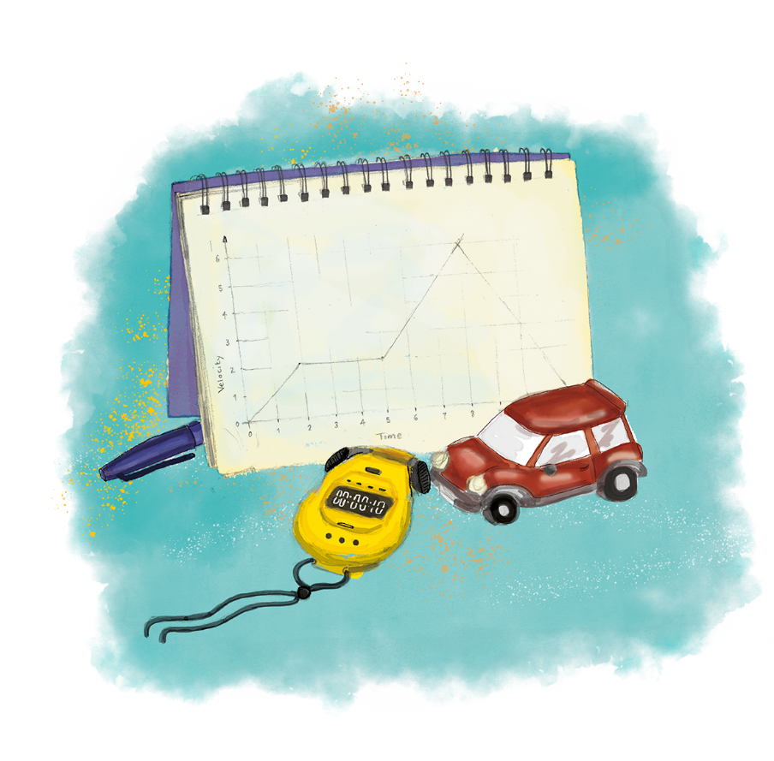


P3.1.5
11/02/2025
Newton’s Third Law
P3.1.1 Prior Knowledge Review
P3.1.2 Scalars and Vectors
P3.1.3 Resultant Vectors
P3.1.4 Resolving Vectors
P3.1.5 Newton's Third Law
P3.1.6 Newton's First Law
P3.1.7 Acceleration
P3.1.8 Acceleration Investigation
Maths in Science Lesson 17
P3.1.9 Velocity-Time Graphs
P3.1.10 Velocity-Time Graphs 2
P3.1.11 Acceleration Problems
Notes:
In P1.1 pupils learned that every action has an equal and opposite reaction. In this lesson they will learn that this law is Newton’s Third Law and that forces always act in pairs. Pupils are covering N3 first because N1 leads naturally into acceleration and changing motion and N2 leads naturally into deceleration and stopping distances so N3 is a relatively straightforward introduction to Newton’s Laws. Note that pupils will not learn about N2 in this unit, although they will use the force mass acceleration practical to learn how to measure acceleration.
Hook:
Get a pupil to stand on a skateboard and push off from a wall. Otherwise simply ask the question: what happens when you’re on a skateboard and you push against a wall? Why?

Slide 4

Following this lesson, students will be able to:
State Newton’s Third Law
Identify pairs of forces
Explain why action-reaction pairs are not the same as balanced forces
Key Words:
action
reaction
exert

Slide 5
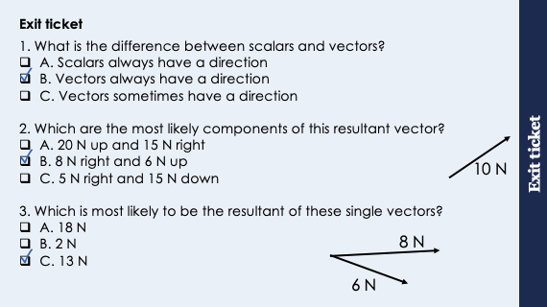
This is the fix-it portion of the lesson
The fix-it is an opportunity to respond to gaps in knowledge, especially those identified by the previous lesson’s exit ticket.
The teacher should customise this slide as needed, to facilitate
reteach, explanation, demonstration or modelling of ideas and concepts that students have not yet grasped or have misunderstood.
practise answering specific questions or of key skills.
redrafting or improving previous work.
Notes:
Suggested Guidance from previous exit ticket:
Q1. Answer: B
If students answered A or C they are not secure on the difference between scalars and vectors. To fix-it, explain the difference between each using examples and how vector quantities are written as answers.
Q2. Answer: B
If students answered A they have understood the relative directions that would produce this resultant but not understood that the components could not be larger than the resultant as it would form the hypotenuse of a triangle. If students answered C they have simply found the difference between the values. To fix-it, it may be worth going through the method again or getting pupils to look at the relative values of their components compared to the resultants.
It may be useful to go through the different scenarios with vectors being combined and show them this working mathematically – i.e. two vectors acting in the same direction will produce the maximum resultant vector, two acting in opposite directions would produce the minimum vector.
Q3. Answer: C
If students answered A they have assumed these vectors are acting in roughly the same direction so can still be added together. If students answered B they have mistakenly subtracted the vectors. To fix-it, you may want to go through with pupils the different combinations of these vectors that would produce each of the resultant options.

Slide 6
General Definition
Scientific Definition
Something done or felt in response to an action, event or situation.
The force that a body (object) subjected to the action of a force from another body exerts in the opposite direction.
Reaction
“Fear is a reaction. Courage is a decision.”
- Winston Churchill
General Examples
Synonyms
Antonyms
We could tell by his reaction the news wasn’t good.
Reply
Answer
Response
Action
Cause
Scientific Examples
Every action has an equal and opposite reaction.
In a chemical reaction, atoms are rearranged but cannot be created or destroyed.
Notes:
Purpose of this slide:
The purpose of the Frayer organiser is to address key scientific vocabulary that students may be familiar with from a non-scientific context. Addressing this at the beginning of the lesson limits the potential cognitive conflict that might arise if students are using their current non-scientific interpretation of a term to understand the science being learned. This approach limits the potential for misconceptions and confusion arising from differing scientific and non-scientific uses of the same word.
The use of this slide is intended to clearly show students
how a word can have both scientific and non-scientific meanings simultaneously
the correct usage of a word in both a scientific and non-scientific context
Teacher guidance:
This slide should be used briefly. Do not dwell on each portion of the slide as this can eat into the lesson quite quickly.
This might be an apt opportunity to ask students to write the scientific definition of the key term into their books. Alternatively, you may want to wait to do this until the term is addressed in more depth later in the lesson.
Suggested narration:
Here we have the word ‘X’. You many already be familiar with this word [display general examples and general definition] in this context. Well, in science, we use this term slightly differently. [display scientific example]. [Display scientific definition]. In science when we use this word what we actually mean is this. You can see that words which mean the same include X,Y and Z. Words that mean the opposite include A, B an C. From this point in the lesson when we refer to this word we’ll be using it in the scientific sense.

Slide 7
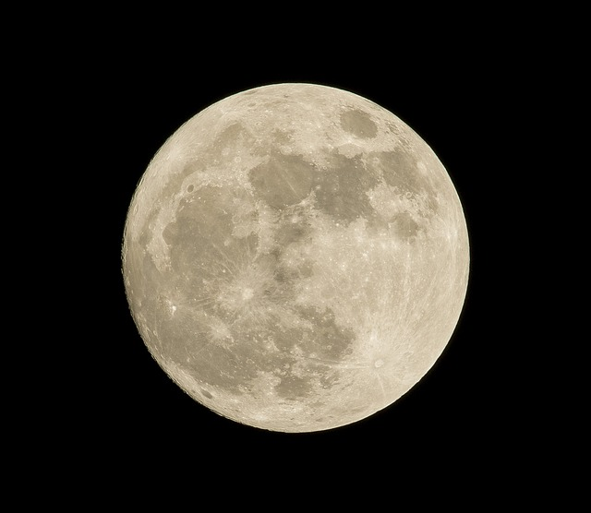
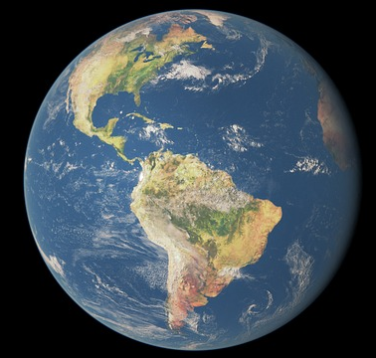
Newton’s Third Law
Did you know?
Isaac Newton’s birthday changed after the Gregorian calendar was adopted in England.
Newton’s Third Law states that every action has an equal and opposite reaction.
When two objects interact, they exert equal and opposite forces on each other.
The forces are acting on different objects.
e.g. the Moon and the Earth
Notes:
Exposition type: Explanation
Suggested exposition:
What happens to a gun when a bullet is fired out of it? Or when a skateboarder pushes off a wall?
A gun firing a bullet will recoil backwards and a skateboarder pushing off a wall will be able to move.
These movements are because of Newton’s Third Law. Isaac Newton was a physicist and mathematician who is one of the most famous scientists of all time and his ideas are still used to the present day. Newton is most famous for his laws of motion and gravitation, which describe how objects interact with each other.
The first of Newton’s Laws that we will look at is Newton’s Third Law. According to Newton’s Third Law, whenever two objects interact they exert (apply) equal and opposite forces on each other. This can also be described as ‘every action has an equal and opposite reaction’. This means that if Object A exerts a force on object B, object B will exert an equal and opposite force on object A.
What does it mean for forces to be equal and opposite?
They are equal in size/magnitude and opposite in direction. Remember that forces are vectors, so are fully described with size and direction.
Let’s think about Newton’s Third Law in action. When a gun fires a bullet, the bullet shoots out forwards at a high speed and the gun itself recoils backwards. In object A is the gun, it exerts a force on the bullet (object B) so the bullet exerts an equal and opposite force on the gun. As it is acting in the opposite direction the gun recoils backwards. The forces they exert on each other are equal, although it may look like the gun exerts more force on the bullet because it accelerates more quickly. They are exerting the same force, but the recoil of the gun has a much smaller acceleration because the mass of the gun is so much greater than the bullet. We will explore this relationship more when we look at Newton’s Second Law.
We can also see Newton’s Third Law when we think about objects staying in orbit. The Earth's gravity pulls the Moon towards the Earth. The Moon exerts an equal and opposite force, pulling the Earth towards it. The effect of this force keeps the moon in orbit but has a negligible effect on the Earth because of its relative mass.
When we describe Newton’s Third Law we always describe it in the form’ object A (e.g. the Earth) exerts a force on object B (e.g. the Moon) and object B (the Moon exerts an equal and opposite force on object A (the Earth)’.
One of the biggest mistakes that pupils make with Newton’s Third Law is that they think because they see the words equal and opposite, this means the same as balanced forces.
What are balanced forces?
When the forces acting on an object are equal in size and opposite in direction, meaning that they cancel each other out.
If we were to draw force diagrams to represent a pair of forces for Newton’s Third Law there would be two separate force diagrams. For example, the force of the Moon on the Earth would only appear on the force diagram of the Earth. There would be a separate force diagram to show the force of the Earth on the Moon, as it is a different object. As the forces are acting on different objects, they are not balanced forces and do not cancel each other out.
Notes:
The example (incorrectly) used at lower levels is often the action-reaction pair of the weight of an object on a table and the reaction force (normal force) is acting on the object. The correct action-reaction pair is the action is the weight of an object and the reaction is the pull of the object on the Earth. The correct action-reaction pair is the force of gravity exerted by each object on the other. It is best to use examples where weight is not one of the forces being considered, sticking to horizontal pairs, such as recoil of a gun or hitting an object.
Misconception – pupils will see the words equal and opposite and assume that means that the resultant force will be 0 because the forces cancel out. This is not the case because the forces are acting on different systems (objects).
You may also may want to be careful when introducing the term action-reaction pair, as pupils will assume that ‘action’ implies the object must be in motion, which is not the case.

Slide 8
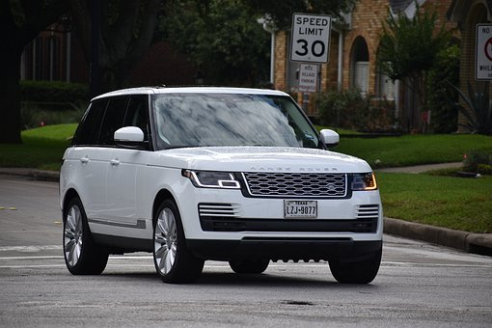
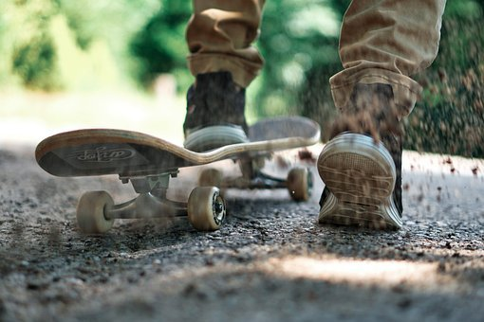

Newton’s Third Law
Newton’s Third Law also explains how objects are able to move
What are the pairs of forces acting in each scenario?
A
B
C
The tyres exert a force on the road and the road exerts an equal and opposite force on the tyres.
The foot exerts a force on the ground and the ground exerts an equal and opposite force on the foot.
The swimmer exerts a force on the water and the water exerts an equal and opposite force on the swimmer.
Notes:
Exposition type: Explanation
Suggested exposition:
Newton’s Third Law also explains how objects are able to move.
If I was to stand on a skateboard and push against a wall, I am exerting a force on the wall so the wall exerts an equal and opposite force on me - which makes my skateboard move.
What are the pairs of forces acting in each scenario? Note that we do not need to name specific forces in these cases, it is sufficient to describe as ‘the force of X on Y’.
The tyres exert a force on the road (pushing the road backwards) and the road exerts an equal and opposite force on the tyres, pushing the car forwards.
The foot exerts a force on the ground (pushing the ground backwards) and the ground exerts an equal and opposite force on the foot, pushing the foot forwards.
The swimmer exerts a force on the water (pushing the water backwards) and the water exerts an equal and opposite force on the swimmer, pushing the swimmer forwards.
Image source: pixabay

Slide 9
Quick Quiz:
State Newton’s Third Law .
Identify the pair of forces acting between the Earth and a satellite.
Identify the pair of forces acting when a girl is pushing off the ground to move her skateboard.
Describe what will happen if two ice skaters push off from each other.
Every action has an equal and opposite reaction.
The force (pull of gravity) of the Earth on the satellite and the force (pull of gravity) of the satellite on the Earth.
The girl pushing the ground with her foot, the ground exerts an equal and opposite force on the girl’s foot.
They will move away in opposite directions because they have exerted an equal and opposite force on each other.
Notes:
Purpose: review of new information.
Give thinking time and 3,2,1 to minimise copying. Use questioning to explain why statements are false and correct false statements.
This is really useful to come back to after Newton’s second law has been covered – but you may want to discuss it with more able pupils now. The force is equal but because the people/objects may have different masses, their acceleration and the distance/velocity they travel away to/at will differ.
Pupils will often ask why gravity pulls us towards the earth. Weight pulls us down to earth, reaction force is that we are pulling up the Earth – the force is the same but using Fnet=ma, the masses are so different that the acceleration of the Earth is infinitely small.

Slide 10

Is this correct?
Newton’s Third Law means that forces are always balanced because the forces are equal and opposite, which means they cancel each other out
Notes:
This is the classic misconception around Newton 3 - that pupils see the term equal and opposite and assume that means the forces are balanced. This is incorrect because the forces are acting on different objects.
Guidance: you may want to use this as a vote before getting pupils to explain their choice, drawing out their thinking. It may be helpful to draw out the force diagrams of an example to show pupils that the forces are acting on different objects, e.g. the force of a gun expelling a bullet and the force of the bullet pushing back on the gun.
Suggested guidance:
Talk tasks can be used in a variety of ways to suit the particular needs of the students you are teaching. Through exchanging views with others, students develop their understanding of the science beyond what could be achieved individually.
Science classrooms that successfully integrate talk have the following features:
Science talk is a regular feature of lessons and is woven into classroom activities.
Students are paired or grouped strategically by the teacher to ensure productive interaction. This might take into consideration the students’ proficiency of the English language, how encouraging they might be to peers and their attainment in the topic. It’s a good idea to consider these pairings in the class seating plan.
Students are encouraged and supported to talk, but are not forced to talk.
The teacher should take on the role of a facilitator, engaging with conversations where necessary and encouraging or steering the conversation where needed.
Students are encouraged to use the language they have to express their ideas (e.g., everyday language, imperfect English, native language), but also to incorporate science specific terminology where this is more accurate or has been taught.
6. Scientifically inaccurate ideas are not dismissed by the partner or teacher; open discussion and further investigation are relied on to help students construct ideas that support them to progress in their scientific understanding.
7. Guidelines for behaviour during talk tasks are explicit and frequently reviewed. Rules for students might be:
Listen carefully to your partner
Take turns talking.
Speak one at a time, without interrupting.
Politely agree or disagree and explain why.
Politely point out if your partner has used a scientific word incorrectly, if they have explained the science incorrectly, or if there is a more accurate way to describe something.
If confused, ask questions.
Stay focused on the discussion topic.
Respond to one another.

Slide 11
Drill
What is a reaction force?
What is Newton’s third law?
If forces are equal and opposite the resultant force will be…
If object A exerts a force on object B, what will object B do?
Why can you float on water?
Why do two skaters move in opposite directions if they push each other?
Why does a book stay on the table??
Notes:
Purpose: This is a knowledge drill. The purpose of this is to check that the critical knowledge is secure before pupils move onto independent practice.
Suggested guidance: There are a range of ways this could be done depending on time and ability range of the class:
Mini whiteboards
As full sentences in exercise books
As short answers in exercise books
In the pupil workbook
As pair talk
As cold call

Slide 12
Drill answers
A force acting in the opposite direction
Newton’s third law states that every action has an equal and opposite reaction
0N
Object B will exert an equal and opposite force on object A.
You float because you exert a force on the water and the water exerts an equal and opposite force on you.
Skaters move in opposite directions when they push each other because they have exerted an equal and opposite force on each other
The book exerts a force on the table, the table exerts an equal and opposite force on the book.
Notes:
Purpose: This is a knowledge drill. The purpose of this is to check that the critical knowledge is secure before pupils move onto independent practice.
Suggested guidance: There are a range of ways this could be done depending on time and ability range of the class:
Mini whiteboards
As full sentences in exercise books
As short answers in exercise books
In the pupil workbook
As pair talk
As cold call

Slide 13
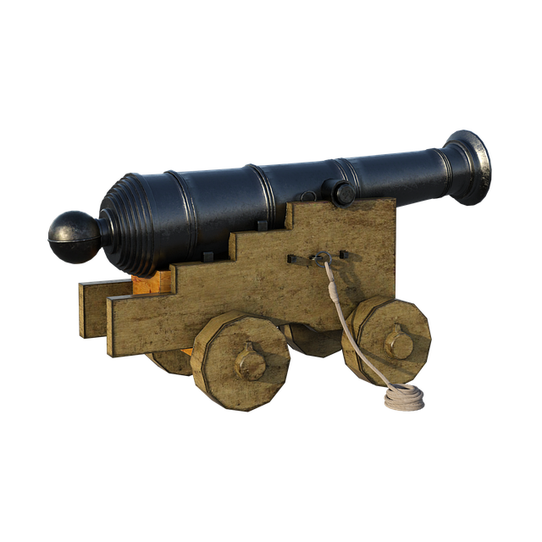

I: Explain: to use scientific understanding to make something clear or state the reason for something happening
Example question:
To ‘explain’ your answer should:
Begin with a scientific statement.
Use ‘this means that’, ‘because’ or ‘so’ to link your statement to the question.
Explain why a cannon recoils when it fires a cannonball.
Model answer:
The cannonball fires the ball forward, causing the cannon to be pushed backwards.
This is because the cannon and the cannonball exert equal and opposite forces on each other.
Notes:
Image from pixabay
This slide models the process of answering an explain question.
Firstly, students are presented with a generic explain question, along with a model answer. Students are also given some simple guidance to follow for producing their own describe answer.
The generic question and answer should be used by the teacher to remind students of
the key features of a great answer
how to structure their answer
why the model answer is a good example
Following this, students will be required to apply this process to answer their own explain question, which will appear in place of the generic questions. This explain question will be specific to the topic students are learning about in the lesson. Give students time to write their own answer to this, ensuring that they use the guidance provided. To further scaffold this task for students, it may be appropriate to:
pair students up to write an answer together
list for students the key words you would like them to include in the answer
provide a writing frame or ‘points to include’ for students
A model answer for this question will appear. Teachers should review the model answer with students by referencing the guidance in the green box. For example ‘we can see item 1 in the guidance is to begin with a scientific statement. Notice in the model answer here we have done just that’. Or ‘item 2 in the guidance here says that we should use a linking statement in the answer. Has this been achieved in the model answer? Where can we see this?’.

Slide 14

We: Explain: to use scientific understanding to make something clear or state the reason for something happening
Example question:
To ‘explain’ your answer should:
Begin with a scientific statement.
Use ‘this means that’, ‘because’ or ‘so’ to link your statement to the question.
Explain why a skateboard moves backwards when a person jumps off it.
Model answer:
The person would jump forward off the skateboard causing the skateboard to be pushed backwards.
This is because the person and the skateboard exert equal and opposite forces on each other.
Notes:
Image from pixabay
This slide models the process of answering an explain question.
Firstly, students are presented with a generic explain question, along with a model answer. Students are also given some simple guidance to follow for producing their own describe answer.
The generic question and answer should be used by the teacher to remind students of
the key features of a great answer
how to structure their answer
why the model answer is a good example
Following this, students will be required to apply this process to answer their own explain question, which will appear in place of the generic questions. This explain question will be specific to the topic students are learning about in the lesson. Give students time to write their own answer to this, ensuring that they use the guidance provided. To further scaffold this task for students, it may be appropriate to:
pair students up to write an answer together
list for students the key words you would like them to include in the answer
provide a writing frame or ‘points to include’ for students
A model answer for this question will appear. Teachers should review the model answer with students by referencing the guidance in the green box. For example ‘we can see item 1 in the guidance is to begin with a scientific statement. Notice in the model answer here we have done just that’. Or ‘item 2 in the guidance here says that we should use a linking statement in the answer. Has this been achieved in the model answer? Where can we see this?’.

Slide 15

You: Explain: to use scientific understanding to make something clear or state the reason for something happening
Example question:
To ‘explain’ your answer should:
Begin with a scientific statement.
Use ‘this means that’, ‘because’ or ‘so’ to link your statement to the question.
Explain why these ice skaters move off in different directions when they push each other.
Model answer:
The skaters would move off in opposite directions
This is because they exert equal and opposite forces on each other
Notes:
Image from pixabay
This slide models the process of answering an explain question.
Firstly, students are presented with a generic explain question, along with a model answer. Students are also given some simple guidance to follow for producing their own describe answer.
The generic question and answer should be used by the teacher to remind students of
the key features of a great answer
how to structure their answer
why the model answer is a good example
Following this, students will be required to apply this process to answer their own explain question, which will appear in place of the generic questions. This explain question will be specific to the topic students are learning about in the lesson. Give students time to write their own answer to this, ensuring that they use the guidance provided. To further scaffold this task for students, it may be appropriate to:
pair students up to write an answer together
list for students the key words you would like them to include in the answer
provide a writing frame or ‘points to include’ for students
A model answer for this question will appear. Teachers should review the model answer with students by referencing the guidance in the green box. For example ‘we can see item 1 in the guidance is to begin with a scientific statement. Notice in the model answer here we have done just that’. Or ‘item 2 in the guidance here says that we should use a linking statement in the answer. Has this been achieved in the model answer? Where can we see this?’.

Slide 16
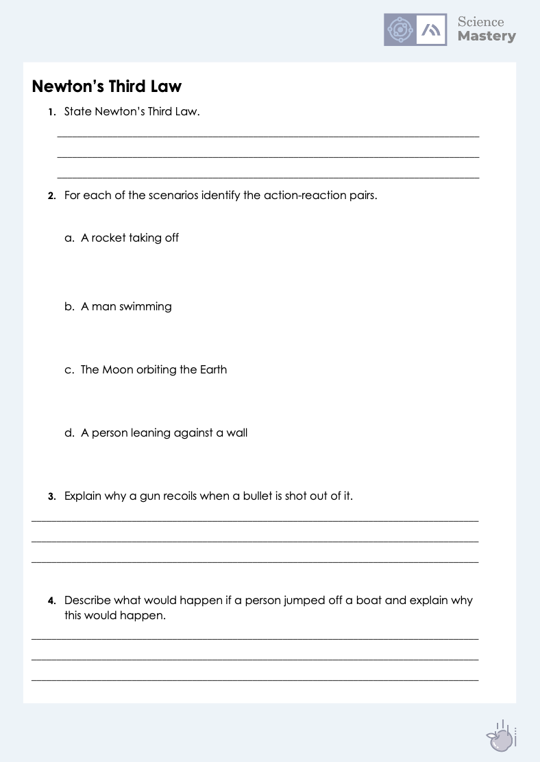
Newton’s Third Law
Complete the worksheet on Newton’s Third Law
Use full sentences where necessary
You may draw diagrams to help you understand the directions of the forces
Notes:
Purpose: practice application of new knowledge in current context.
Mark scheme provided to self/peer assess answers.

Slide 17
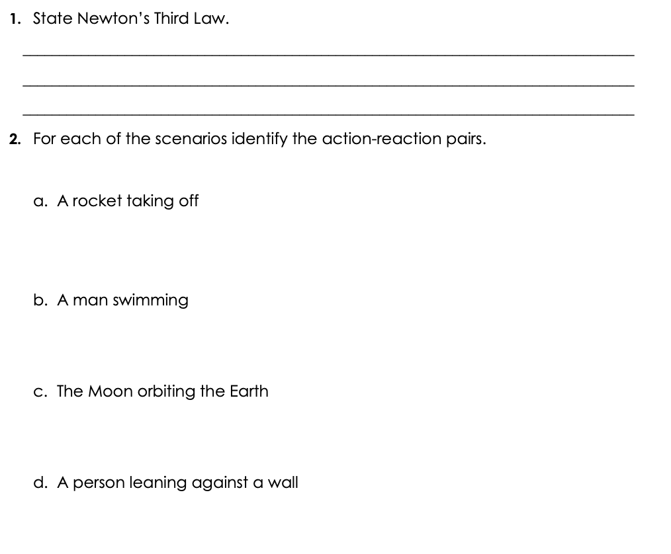
Answers
Every action has an equal and opposite reaction (If object A exerts a force on object B, object B will exert an equal and opposite force on object A).
The force of the rocket on the ground (thrust of the engine)
The force of the ground on the rocket
Man pushing the water backwards
Water pushing the man forwards
Pull of gravity of Earth on the Moon
Pull of gravity of Moon on the Earth
Force of person pushing against wall (not weight because weight acts downwards)
Reaction force of wall pushing against person

Slide 18
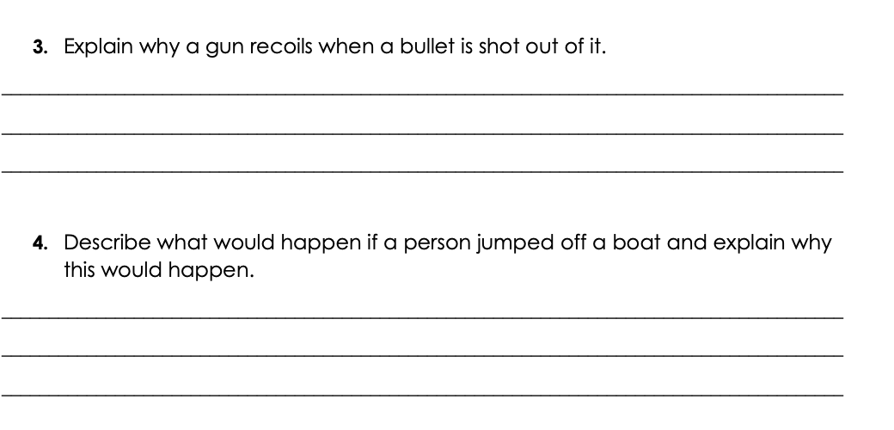
Answers
The gun and the bullet exert equal and opposite forces on each other so when the bullet is pushed forward it pushes the gun backwards.
It does not accelerate as quickly as the bullet because it has a much greater mass.
The person would jump forward off the boat causing the boat to be pushed backwards. This is because the person and the boat exert equal and opposite forces on each other.

Slide 19

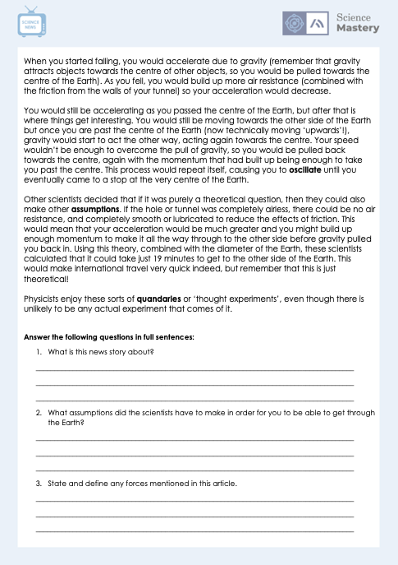
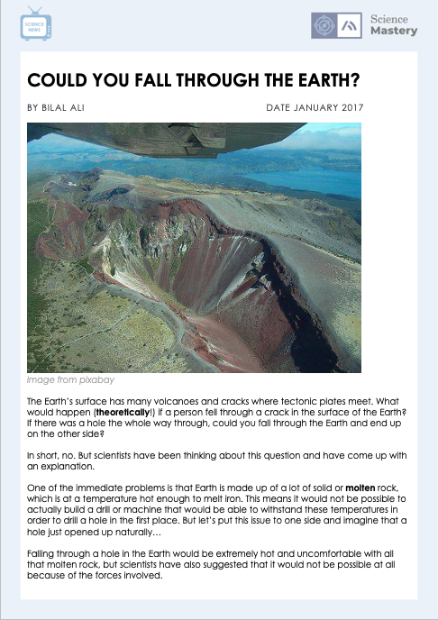
Newton’s Third Law
Complete the Science in the News Activity
Answer in full sentences
State the definitions of any words in bold

Slide 20
Answer the questions below.
1. Newton’s Third Law states that …
A. Objects will exert equal and opposite forces on each other that will cancel out
B. If an object exerts a force on another it will exert the same force
C. Every action has an equal and opposite reaction
2. The reaction force to the force exerted by a gun on a bullet is…
A. The weight of the gun
B. The force exerted by the bullet on the gun
C. The air resistance of the bullet
3. If a large person and a small person bump into each other what can be said about the forces they exert on each other?
A. The large person will exert a larger force
B. The small person will exert a larger force
C. They will exert the same size force on each other
✓
✓
✓
Notes:
Suggested Guidance:
Q1. Answer: C
If students answered A or B, they are not secure on the definition behind Newton’s Third Law. To fix-it, compare N1 and N3 after introducing N1 in the next lesson so pupils have to correctly identify which is which.
Q2. Answer: B
If students answered A or B, they have not understood how to identify the action-reaction pair. To fix-it, practice with pupils using the sentence structure ‘when A (e.g. gun) exerts a force on B (bullet), B (bullet) exerts an equal and opposite force on A (gun).
Q3. Answer: C
If students answered A, they have not been able to understand this as an example of an action-reaction pair. To fix-it, it may be useful to model a scenario with two objects crashing into each other to show how the force exerted by each object is equal and opposite. It may also be worth elaborating and discussing the effect that this will have on different masses – i.e. why does a bullet shoot away rapidly but a gun recoils much slower (Fnet=ma, if the force is equal but the masses are different, they will have different accelerations).

Slide 21
Lesson P3.1.5
What was good about this lesson? | What can we do to improve this lesson?
Send us your feedback by clicking this link
or by emailing sciencemastery@arkonline.org
Thank you!

